Slide 1
ARM11 – Assembler & Emulator
17th June 2021
Extension: A Concurrent Application of Blockchain Mining and Exchange in C
Ashvin Arsakularatne
aa9220@ic.ac.uk
Kavya Chopra
kc2320@ic.ac.uk
Siddhant Singh
ss5120@ic.ac.uk
Ye Lun Yang
yly19@ic.ac.uk

Slide 2
EMULATOR

Slide 3
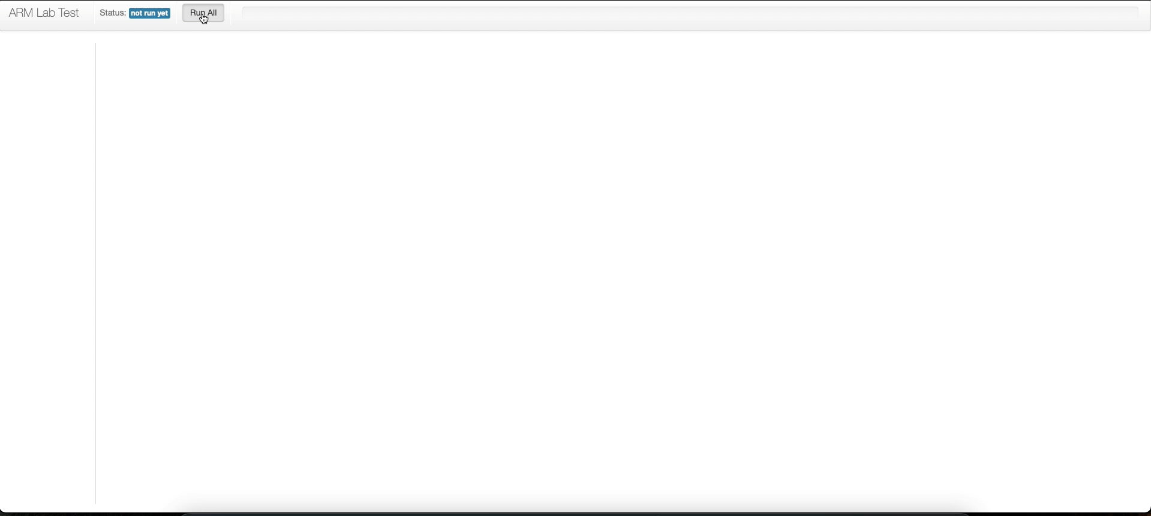
Emulator Test Cases

Slide 4
Roadblock (CSPR flags)

Slide 5
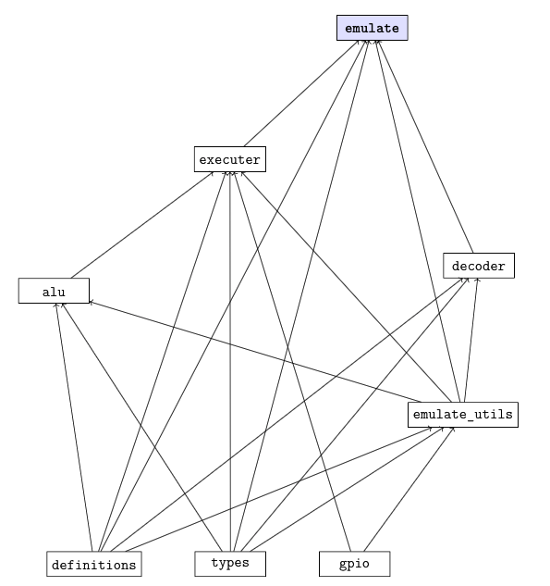
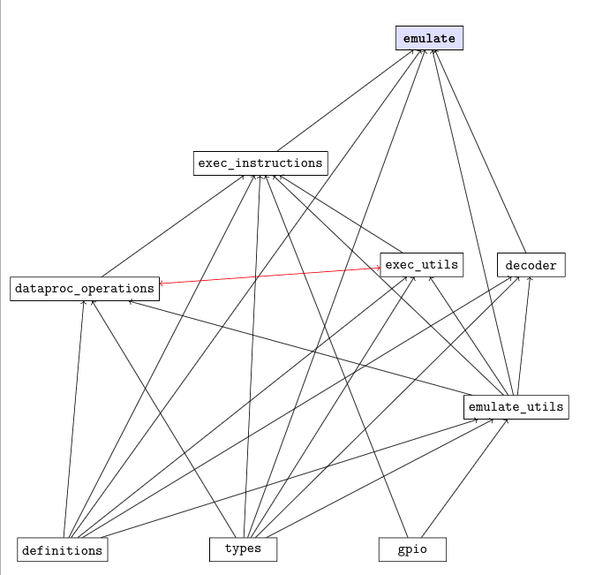
Cyclic File Dependencies

Slide 6
Cyclic File Dependencies

Slide 7
ASSEMBLER

Slide 8
Assembler Test Cases

Slide 9
Interesting Test Cases #1

Slide 10
Roadblock (parse_operand2())
Incomplete code (not fully covering all test cases)

Slide 11
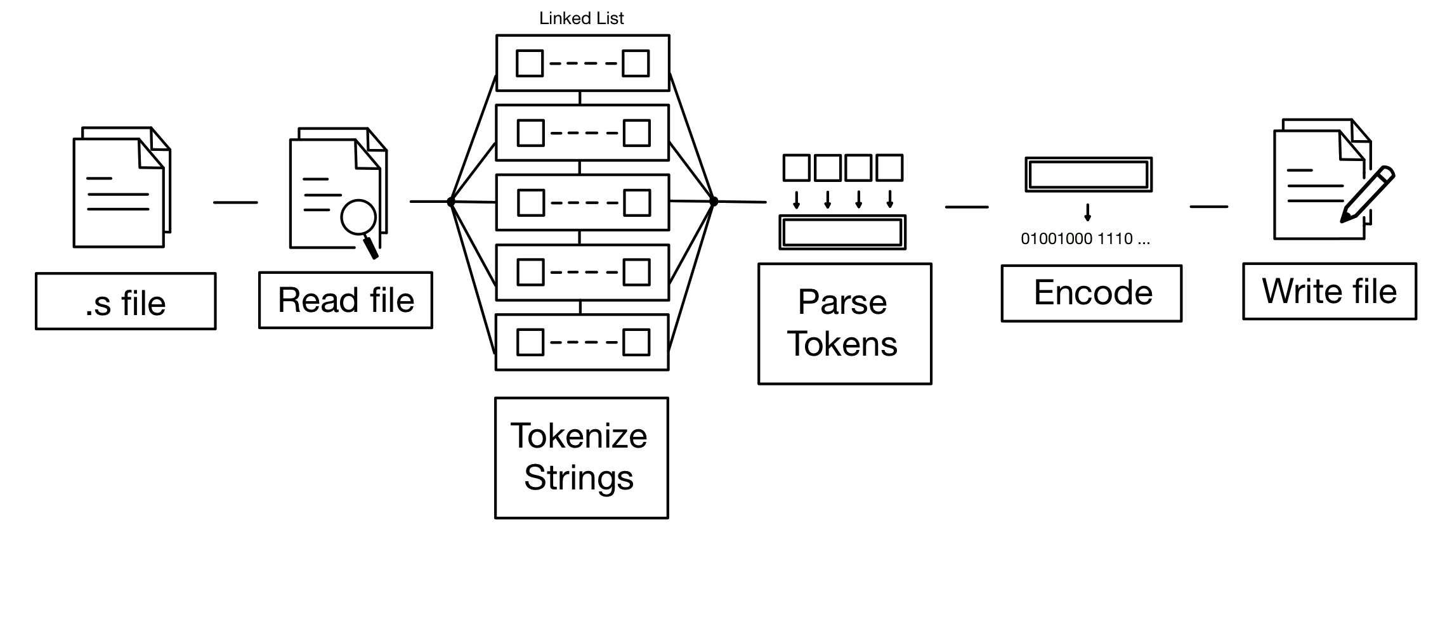
General Structure

